Slide 1
Power BI Embedded
FSI CSU SWARM

Slide 2
Creating accessible content
Take the following steps to create accessible content that everyone can consume effectively.
Contrast
Use high contrast colors for maximum readability
The recommended contrast ratio is at least 4.5:1
Color Contrast Analyzer
Download this tool to determine the legibility of text and the contrast of visual elements
Shape and color
Use different shapes with a legend to indicate statuses to accommodate for color blindness
Example:
Alt text
Alt text helps people with screen readers understand the content of slides
You can create alternative text for shapes, pictures, charts, tables, SmartArt graphics, or other objects
Here’s how:
Right click the image or shape
Select Format Picture… or Format Shape…
Select the Size & Properties icon
Expand the Alt Text field
Enter a Title and Description of your image or object
Slide layouts
Using a built-in slide layout that matches your content ensures a hierarchical reading order of text blocks
Example:
If a new slide will have a title, rather than starting with a blank layout and adding a text block for the title, choose one of the built-in layouts with a title placeholder
Reading order
Screen readers describe content on the screen in the order it was created
To ensure your content is read back in the order you prefer, arrange your objects in the Selection Pane appropriately. Objects on the bottom of the selection pane are read first
Here’s how:
Click the Home tab
In the Drawing group, select the Arrange drop-down menu
Click Selection Pane…
Text
Text
Text
Subject 1
Subject 2
Subject 3
Download
C1
C2
C3
Additional tips!
Be sure to run the Accessibility Checker! Go to File click the Check for Issues drop down menu click Check Accessibility
Videos need to be accessible: If your presentation includes a video, ensure it is captioned and audio described (if appropriate)
Visit the Office Accessibility Center to learn more about accessibility in PowerPoint

Slide 3
Abstract and learning objectives
Abstract and learning objectives
Embed Power BI objects within applications

Slide 4
Embedding Functionalities
Embedding Power BI Content | The Power BI service (SaaS) and the Power BI Embedded service in Azure (PaaS) have APIs for embedding your dashboards and reports. This feature means you can access the latest Power BI features – such as dashboards, gateways, and app workspaces – when embedding your content.

Slide 5
Custom Visuals
Developing Custom visuals | You can use custom visuals with Power BI to create a unique type of visual that’s tailored to you or your company. Often these custom visuals are created by developers. They're built when the multitude of visuals that are included with Power BI don’t quite meet your needs.

Slide 6
Power BI Service
Provides cloud-based foundation for power BI platform
Accessible with browser through https://app.Powerbi.Com
Accessible through power BI mobile apps
Accessible to developers through power BI service API

Slide 7

Using the Power BI Service API
Accessible by making direct REST calls against service
Accessible by using assembly DLL that abstracts away REST calls
Assembly DLL is named microsoft.Powerbi.Api.Dll
Assembly DLL part of nuget package (microsoft.Powerbi.Api)
Calling service requires authentication with azure active directory

Slide 8
Step 1: Review the customer case study
Outcome
Analyze your customer needs
Timeframe
15 minutes

Slide 9
Customer situation
Main topic 1: size 36pt
Size 28pt for second level
Size 24pt for third level
Size 22pt for fourth level
Size 22pt for fifth level

Slide 10
Customer needs
Main topic 1: size 36pt
Size 28pt for second level
Size 24pt for third level
Size 22pt for fourth level
Size 22pt for fifth level

Slide 11
Customer objections
Main topic 1: size 36pt
Size 28pt for second level
Size 24pt for third level
Size 22pt for fourth level
Size 22pt for fifth level

Slide 12
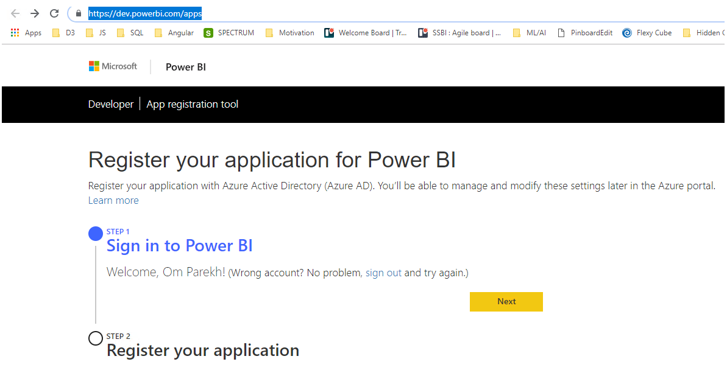
Registered your app for Power BI
Open below URL and Sign-in using Power BI Pro credentials
https://dev.powerbi.com/apps

Slide 13
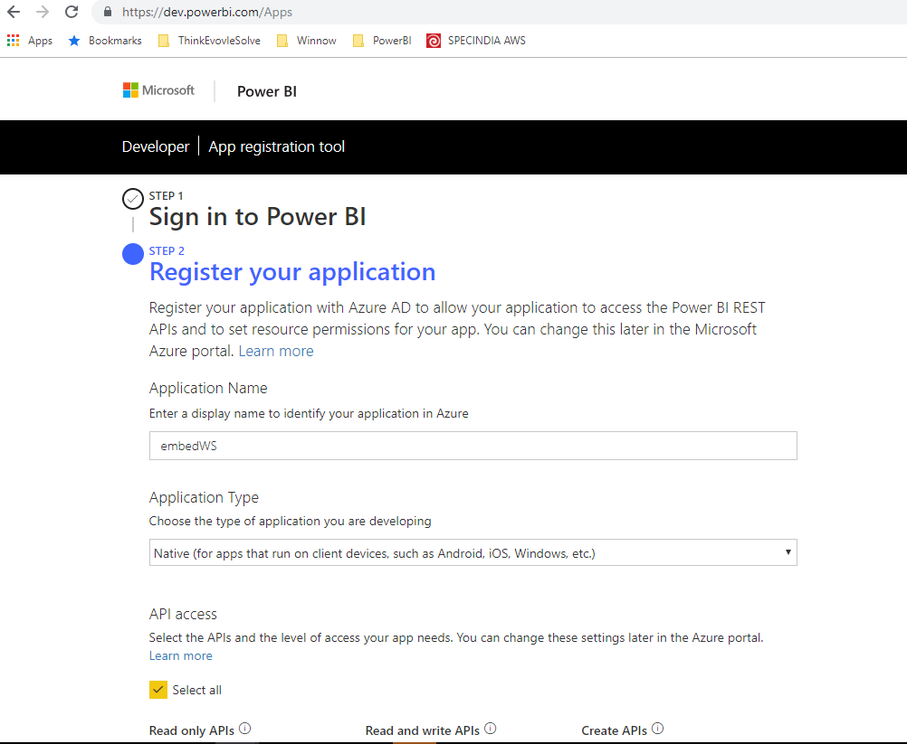
Registered your app for Power BI
Registered App (Step 2)
Please remember Application name, Client Id
Example Client ID : 7114bf2f-8aad-49ad-8a7c-2e80e9b6fbba

Slide 14
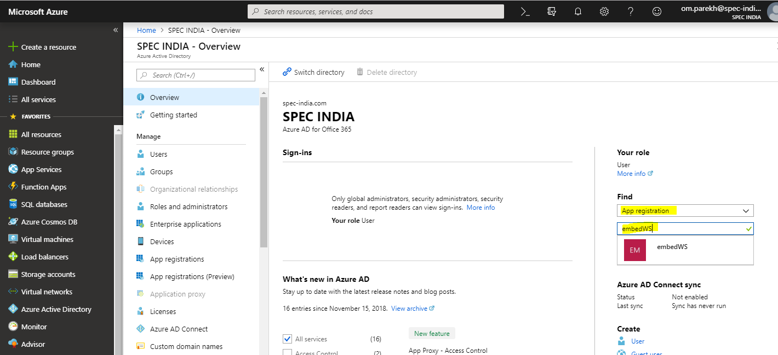
Registered your app for Power BI
Open Azure portal using the same Power BI Pro account and registered your app (Azure Active Directory)
Goto Setting -> Required Permission -> Grant Permission (select All)

Slide 15
Common scenarios
Main topic 1: size 36pt
Size 28pt for second level
Size 24pt for third level
Size 22pt for fourth level
Size 22pt for fifth level

Slide 16
Step 2: Design the solution
Outcome
Design a solution and prepare to present the solution to the target customer audience in a 15-minute chalk-talk format.
Timeframe
60 minutes
Business needs (10 minutes) | Respond to questions outlined in your guide and list the answers on a flipchart
Design (35 minutes) | Design a solution for as many of the stated requirements as time allows. Show the solution on a flipchart
Prepare (15 minutes) | Identify any customer needs that are not addressed with the proposed solution Identify the benefits of your solution Determine how you will respond to the customer’s objections Prepare for a 15-minute presentation to the customer

Slide 17
Step 3: Present the solution
Outcome
Present a solution to the target customer in a 15-minute chalk-talk format
Timeframe
30 minutes (15 minutes for each team to present and receive feedback)
Directions
Pair with another table
One table is the Microsoft team and the other table is the customer
The Microsoft team presents their proposed solution to the customer
The customer asks one of the objections from the list of objections in the case study
The Microsoft team responds to the objection
The customer team gives feedback to the Microsoft team

Slide 18
Wrap-up
Outcome
Identify the preferred solution for the case study
Identify solutions designed by other teams
Timeframe
15 minutes

Slide 19
Preferred target audience
Main topic 1: size 36pt
Size 28pt for second level
Size 24pt for third level
Size 22pt for fourth level
Size 22pt for fifth level

Slide 20
Preferred solution
Main topic 1: size 36pt
Size 28pt for second level
Size 24pt for third level
Size 22pt for fourth level
Size 22pt for fifth level

Slide 21
Preferred objections handling
Main topic 1: size 36pt
Size 28pt for second level
Size 24pt for third level
Size 22pt for fourth level
Size 22pt for fifth level

Slide 22
Customer quote
Main topic 1: size 36pt
Size 28pt for second level
Size 24pt for third level
Size 22pt for fourth level
Size 22pt for fifth level

Slide 24
Text layout (without bullet points)
Main topic 1: size 36pt
Size 28pt for second level
Size 24pt for third level
Size 22pt for fourth level
Size 22 for fifth level

Slide 25
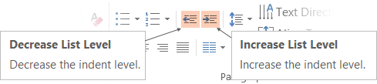
Text with bullet points - adjusting list levels
Main topic 1: size 36pt
Size 28pt for second level
Size 24pt for third level
Size 22pt for fourth level
Size 22 for fifth level
Use the “Decrease List Level” and “Increase List Level” tools on the Home Menu to change text levels.
Try this:
Place your cursor in any row of text to the left that says “Size 20pt for subtopics”
Next click the Home tab, and then on the “Decrease List level” tool. Notice how the line moves up one level.
Now try placing your cursor in one of the “Main topic…” lines of text. Click the “Increase List Level” tool and see how the text is pushed in one level
Use these 2 tools to adjust your text levels as you work

Slide 26
Bullet points layout with subtitle Subtitle is smaller in the same text block
Example of a bulleted slide with a subhead
Set the slide title to “Sentence case”
Set subheads to “Sentence case”
Hyperlink style
www.microsoft.com

Slide 27
Photo layout 1

Slide 28
Demo

Slide 29
Video

Slide 30
Section title

Slide 31
Software code slide
This slide layout uses Consolas, a monotype font which is ideal for showing software code.

Slide 32
Notes (hidden)
Some speakers at Microsoft like to use this slide for hidden “notes slides”.
Delete it if you don’t want to use it.
NEXT: <next slide title>

